Slide 1
Song Data Mining
Harsh Bolakani
Greg Morgan
Trevor Pawlewicz

Slide 2
Introduction and Purpose of Dataset
We will explore the area of music and lyrical content to find trends in popular music according to genre.
We will ask if popular hit music (chart ranking and top selling songs) have trends in the following way:
Are there common words and/or phrases?
Are the common themes?
What words can be used in a specific genre to write a popular song lyric?
We would like to give developers a dataset to create phrases to help write a popular song in a specific genre.

Slide 3
Potential Users and Applications
Create inspiration for musicians.
Help musicians over creative road-blocks.
Assist content producers in creating the perfect song to fit their needs.
Looking at trends in genres to collect a dataset for lyrical inspiration.
For an audience of…
Musicians
Writers
Producers

Slide 4

Source of Data
Musixmatch lyrics API
Musixmatch is the world’s leading music data company with largest lyrics database with more than 14 million lyrics in over 50 distinct languages.
The fastest, most powerful and legal way to display lyrics on your website or in your application.
Musixmatch lyrics API is a robust service that permits you to search and retrieve lyrics in the simplest possible way.
https://developer.musixmatch.com

Slide 5

Source of Data
Genius.com: web scraping song lyrics
The world's biggest music encyclopedia with a passionate community of more than two million contributors, Genius is a destination for artists, creatives, and superfans to discuss and deconstruct all things music.
Founded in 2009, Genius is a unique media company that serves music knowledge to over 100 million people each month on Genius.com and everywhere music fans connect across the internet.
https://genius.com/

Slide 6
Building the Dataset
Register for an API key (musixmatch)
Retrieve song list and genre metadata from API (musixmatch)
Scrape Lyric Data with Beautiful Soup (genius)
Collect and Merge Data
Process Data
Remove Stop Words
Output the Dataset
Notes:
After read of slide, Walkthrough the Jupiter notebook:
https://github.com/TrevorPawlewicz/DSCI-511-Course-Project/blob/main/FinalProject/project-code.ipynb

Slide 7
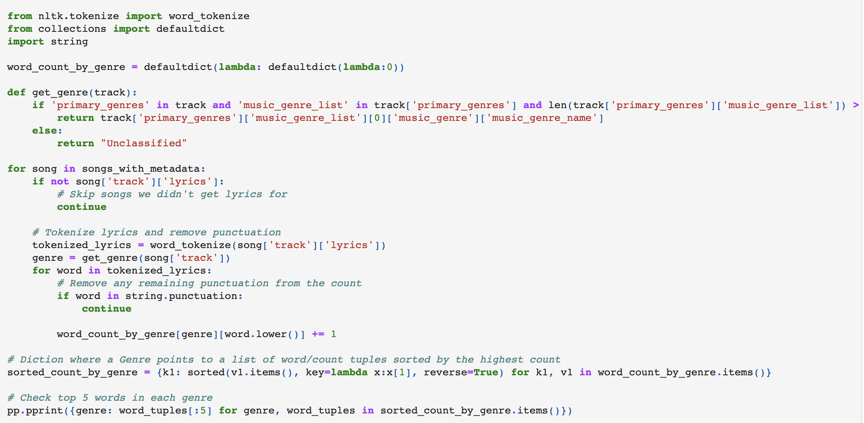
Acquisition & Preprocessing Our Data
Jupyter notebook demo
Notes:
Get the track genre.
Skip songs we didn't get lyrics for.
Tokenize lyrics and remove punctuation.
Remove any remaining punctuation from the count.
Diction where a Genre points to a list of word/count tuples sorted by the highest count.
Check top 5 words in each genre.
Remove Stop words.
Output dataset to JSON file.
https://github.com/TrevorPawlewicz/DSCI-511-Course-Project/blob/main/FinalProject/project-code.ipynb

Slide 8
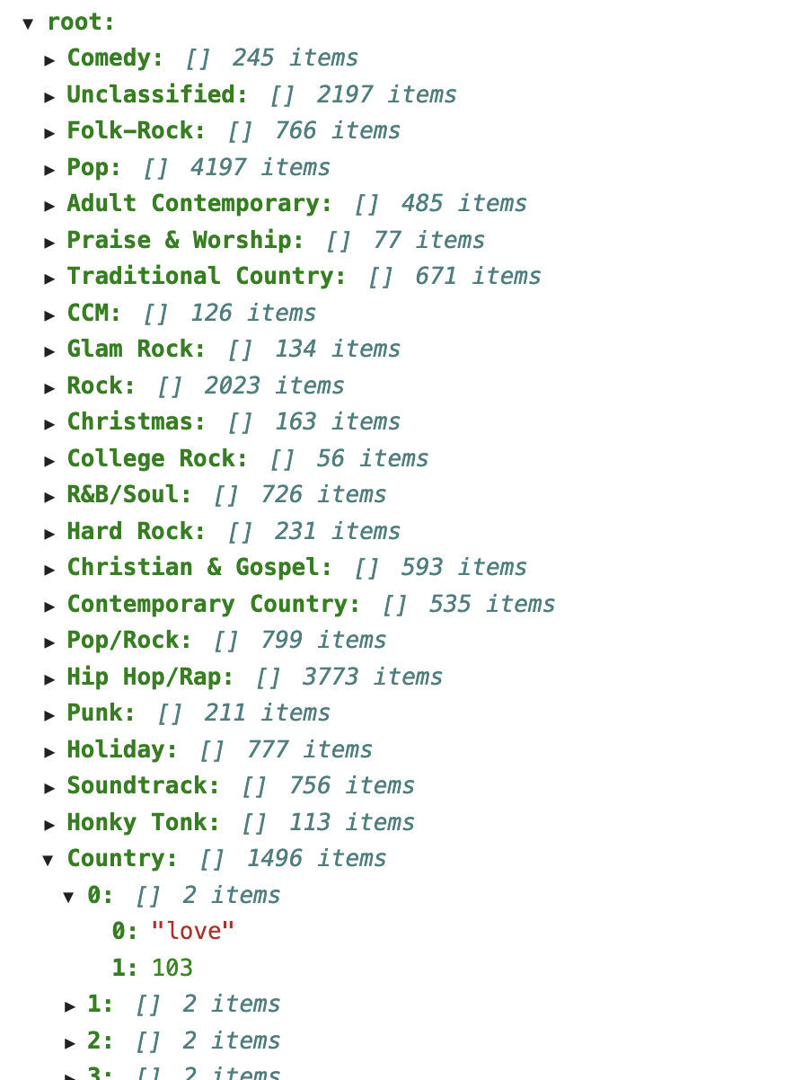

Distribution Approach: JSON file hosted on GitHub https://github.com/TrevorPawlewicz/DSCI-511-Course-Project/tree/main/FinalProject/data

Slide 9
Discussion of Our Dataset Access Rights
Output dataset as JSON file hosted in a Public GitHub Repository.
No Access rights
Open to public consumption
We are not Publishing entire lyrical data.
Word counts vs. Copyrighted Lyrics

Slide 10
Our Dataset Issues and Limitations
Musixmatch:
Limited to 2k API Calls daily
Free testing plan for evaluation only
Access to ONLY 30% of lyrics per song
Understanding which part of the song (beginning, middle, end) contains the lyrics that are needed to be best analyzed for our dataset.
Genius.com was used for web scrapping to get full lyrical content of songs as a solution to only having access to the Musixmatch free 30% of lyrics per song.
Web scrapping decreased our dataset collecting performance.

Slide 11
Team and Contributions
Harsh Bolakani
API Research
Data pre-processing
Greg Morgan
Web Scraping Research
Data acquisition
Trevor Pawlewicz
Idea concept
Product management

Slide 12
Thank You

Slide 13
Appendix

Slide 14
Approach to Acquiring the Data: API
Leverage Spotify API + Genius Lyrics for Data Science Tasks in Python
Install Libraries
Libraries here…
Connecting To Spotify API
register for a Spotify developer account
access to unique tokens which will allow for a seamless connection (client id and secret key)
Extrapolating Data From Spotify API
create a function that will take all the songs from any given album and insert the relevant information into a pandas dataframe.
Attaching Song Lyrics From Genius.com
web scrapping Genius to attach the lyrics of the songs to our dataframe.

Slide 15
Approach to Acquiring the Data: Web Scraping
Web scraping is the process of gathering information from the Internet. Even copying and pasting the lyrics of your favorite song is a form of web scraping!
Step 1: Inspect Your Data Source (Explore the Website)
Understand the site structure to extract the information that’s relevant for you.
Decipher the Information in URLs
Inspect the Site Using Developer Tools
Step 2: Scrape HTML Content From a Page
Find Elements by HTML class name
Step 3: Parse HTML Code With Beautiful Soup
Find Elements and extract by ID, class name, …
Extract Text From HTML Elements
Pass a Function to a Beautiful Soup Method
https://realpython.com/beautiful-soup-web-scraper-python/#step-1-inspect-your-data-source
Notes:
Decipher the Information in URLs
A programmer can encode a lot of information in a URL. Your web scraping journey will be much easier if you first become familiar with how URLs work and what they’re made of.
websites can use query parameters to encode values that you submit when performing a search.
Parse HTML Code With Beautiful Soup
Beautiful Soup is a Python library for parsing structured data. It allows you to interact with HTML in a similar way to how you interact with a web page using developer tools

Slide 16
Approach to Acquiring the Data: Web Scraping
Fetch the main URL HTML code.
Feed that HTML to BeautifulSoup.
Extract each song from the list and get the wiki link of each book.
Obtain lyrical data for each song.
Get all songs lyrical data, clean, and plot final results.
Notes:
Decipher the Information in URLs
A programmer can encode a lot of information in a URL. Your web scraping journey will be much easier if you first become familiar with how URLs work and what they’re made of.
websites can use query parameters to encode values that you submit when performing a search.
Parse HTML Code With Beautiful Soup
Beautiful Soup is a Python library for parsing structured data. It allows you to interact with HTML in a similar way to how you interact with a web page using developer tools

